Slide 1
Singing blades of grass 10.
Bánóczki Tímea
Budapest XX. Kerületi Német Nemzetiségi Gimnázium és Kollégium

Slide 2
Singing Blades of Grass It is possible to produce a sound by blowing across a blade of grass, a paper strip or similar. Investigate this effect.
Blowing across blade of grass

Slide 3
Outline of my presentation
1. Experimental set up
2. Theoretical approaches
3. Results
A) Effect of length
B) Effect of cross-section
C) Effect of stress force
D) Hysteresis
E) Quality of material
F) Cross direction vibration
G) Volume-examination of the amplitude of the vibration
4. Instrument model
5. Summary of results
6. Sources
7. Appendix

Slide 4
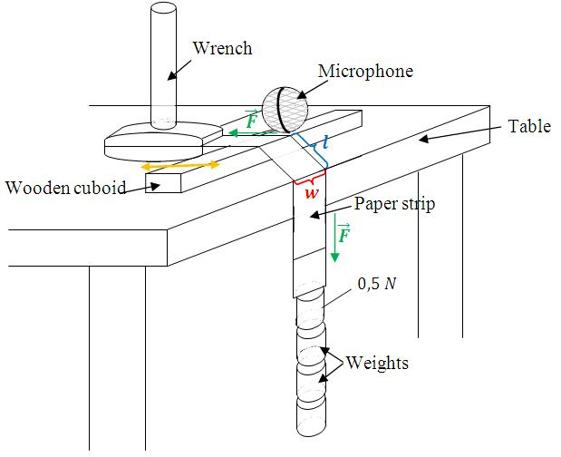
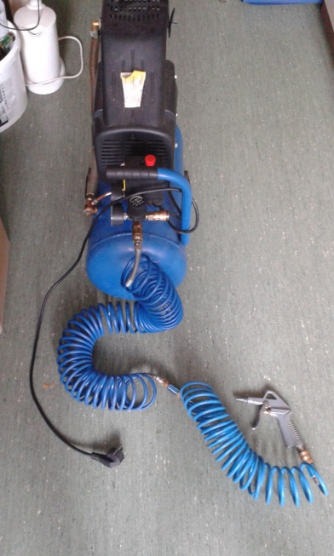
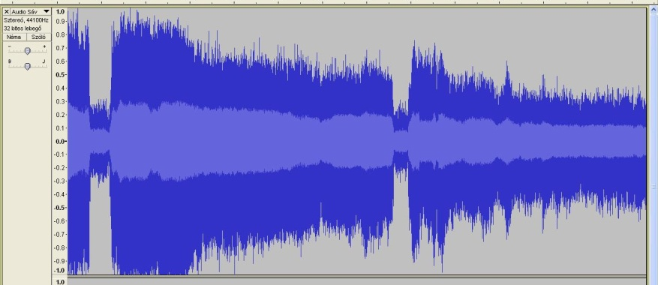
1.1 Experimental set up and the analyses programs
Figure 4.1. Experimental set up
Figure 4.2. Compressor
Figure 4.1. Experimental set up
Figure 4.4. Scope
Figure 4.3. Audacity
f₀
Notes:
4.1. EGÉSZ DIA AZTÁN BEHÚZODIK A SAROKBA

Slide 5
2.1. Theoretical Approaches-Turbulent flow
A turbulent flow of the air → The density and the pressure periodically changing in the stream → the paper strip vibrate.
Figure 5.1. Demonstration of turbulent flow around a cylinder
Figure 5.2. The vibration of paper strip
Notes:
And now let see the basic theorem behind the sound of a paper strip

Slide 6
2.2. Theoretical approaches- Reynolds-number
(1)
Re: Reynolds-number, ρ: density of the air, v: speed of the air, d: width of the paper strip, η: dynamical viscosity of the air, ν: kinematic viscosity of the air
The flowing air around a cuboid cross-section paper strip is turbulent, if the Re>700[1].
Minimal speed for turbulent flow in our experiment
Notes:
We wanted to find out the minimal airspeed for a vibrating stip. That is why we´ve used the Reynolds. formjula

Slide 7
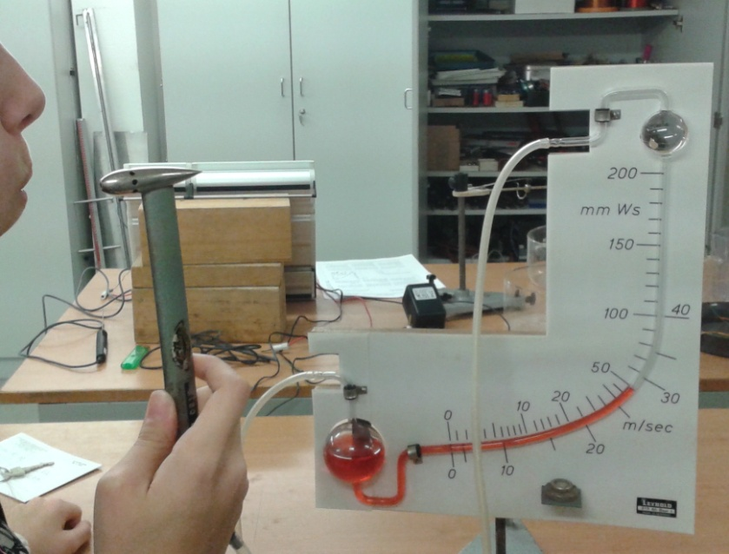
Reynolds-number
speed of the blowing air of a human
Speed of the out coming air of the compressor v>280 m/s (the air is already turbulent)
Figure 7.1.
The measurement of the speed of out flowing air with the help of a Pitot-Prandtl-tube
Figure 7.2.
The vibration of a paper strip at low pressure

Slide 8
2.3. Theoretical approaches-string model
Similarity between strings and a blade of grass or not too wide paper strip.
In the case of strings, we can calculate the created frequencies (fundamental frequency and harmonics) as it follows[2]:
(2)
f: frequency, n: order of the harmonics, F: stress force, q: cross-section of the string, ρ: density of the string, l: length of the string

Slide 9
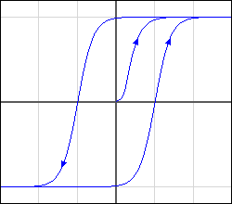
2.4. Theoretical Approaches-Hysteresis
Maybe stress force has a hysteresis effect [3] on the material???
(M)
(H)
Figure 9.1. Sample for a hysteresis curve: magnetization (M) in the function of magnetic field(H)

Slide 10
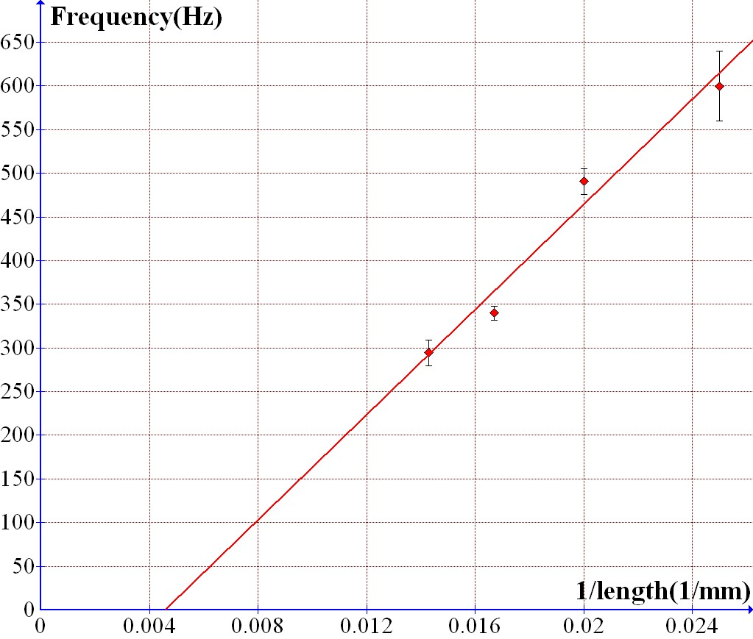
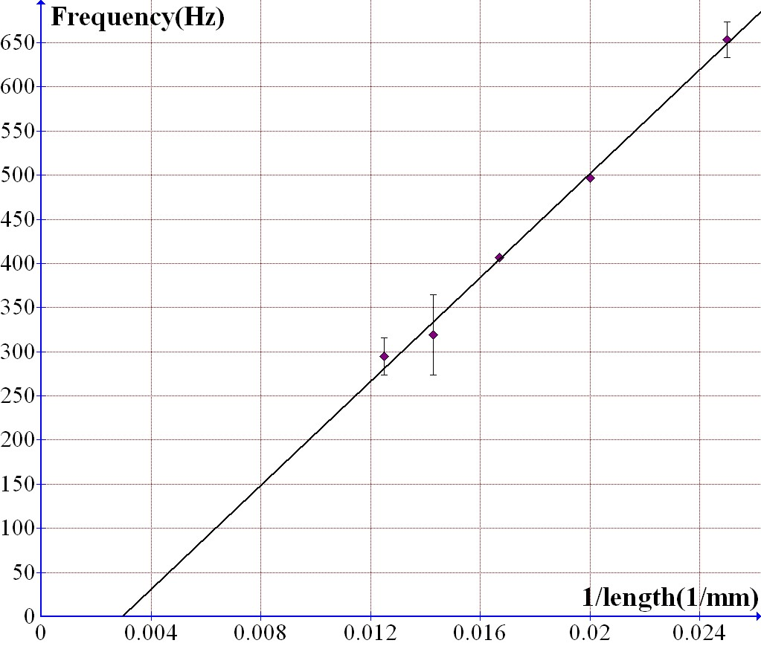
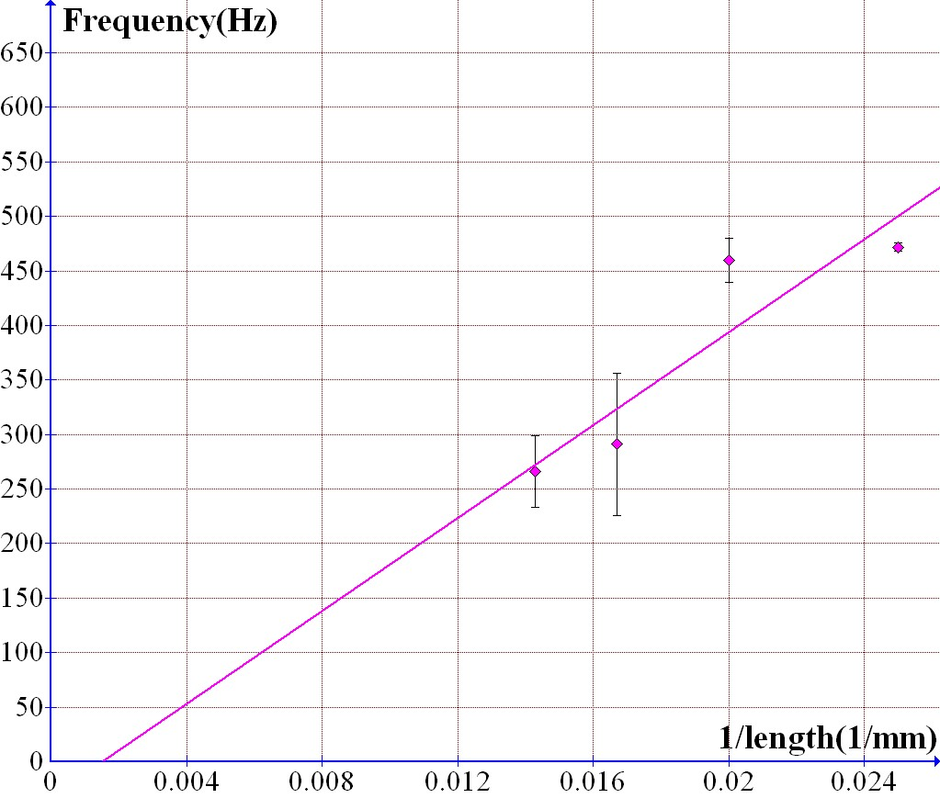
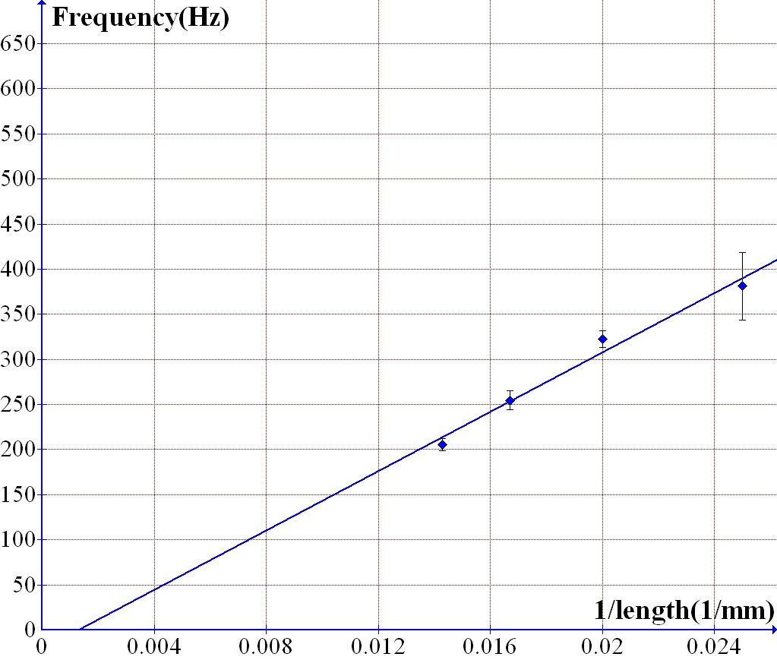
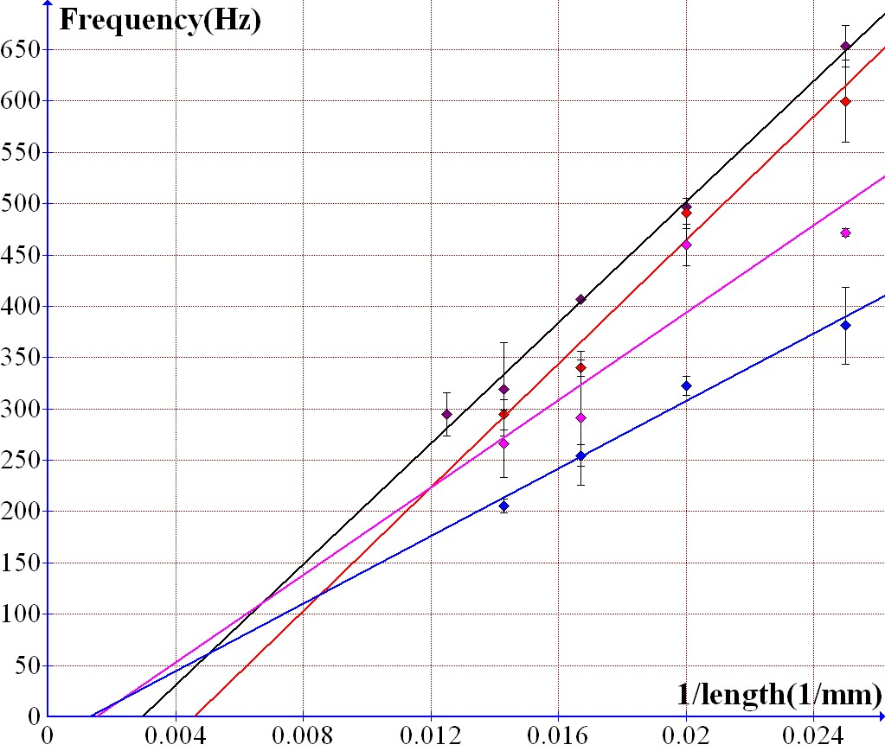
3. A) Effect of length
Figure 10.1. Fundamental frequencies in the function of the reciprocal of length in the case of 10-25mm wide paper strips

Slide 11
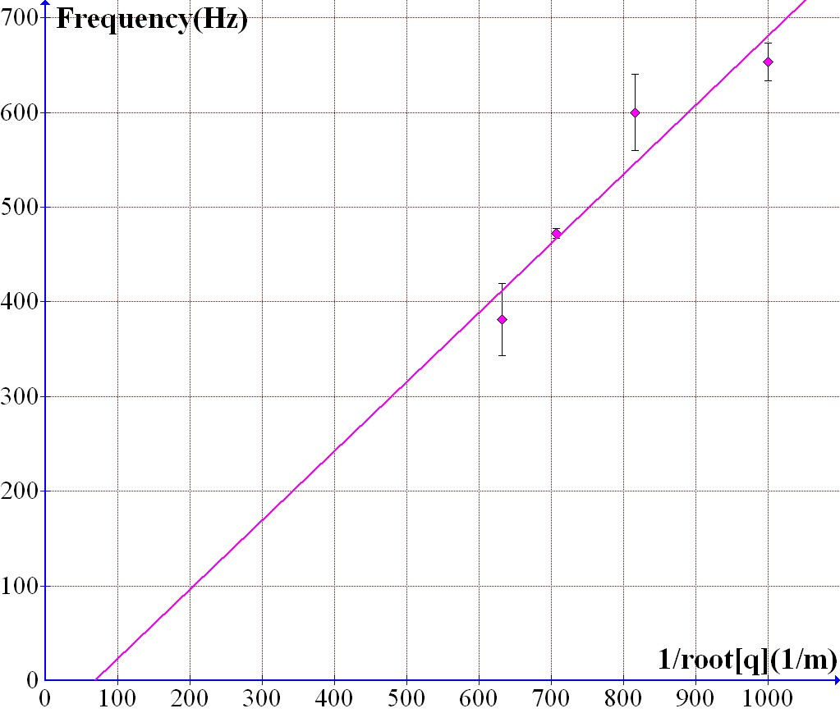
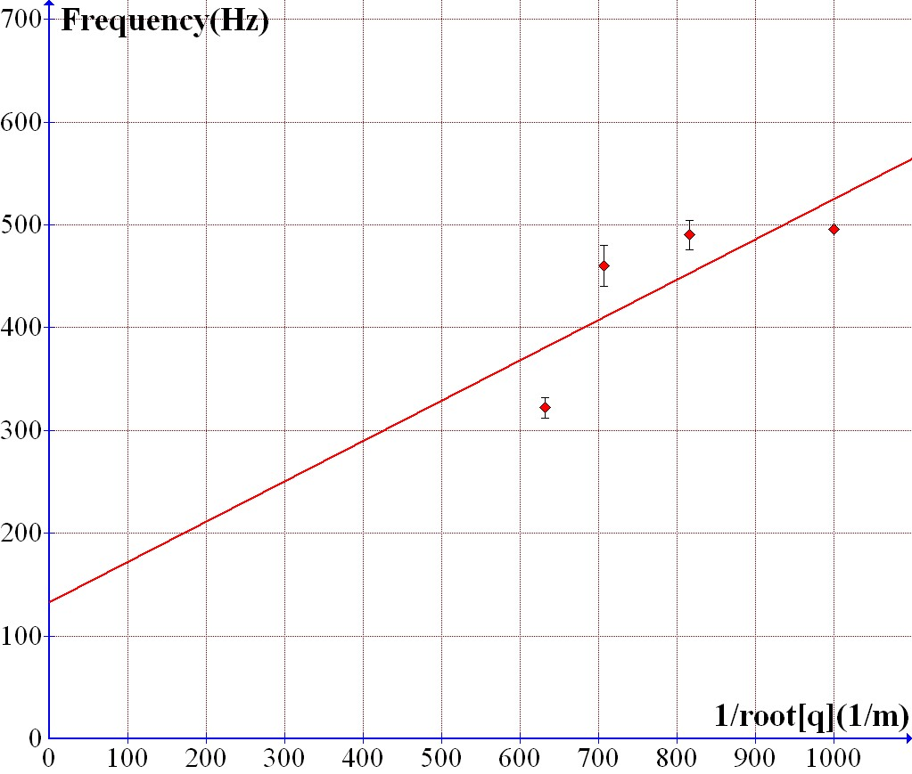
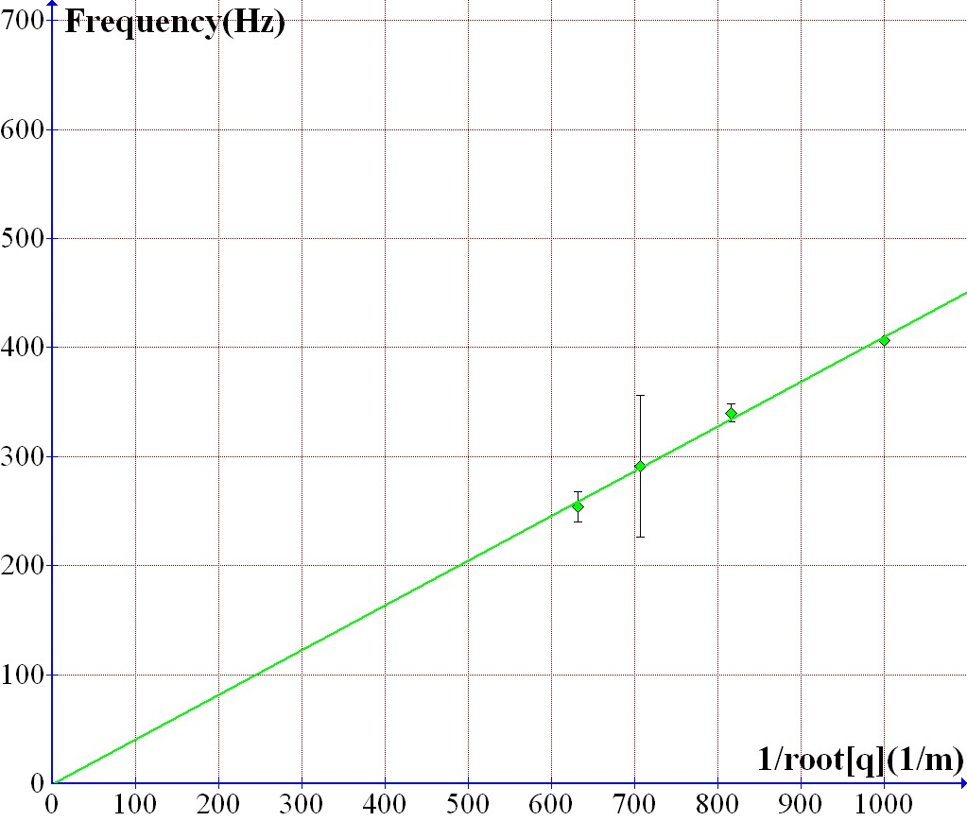
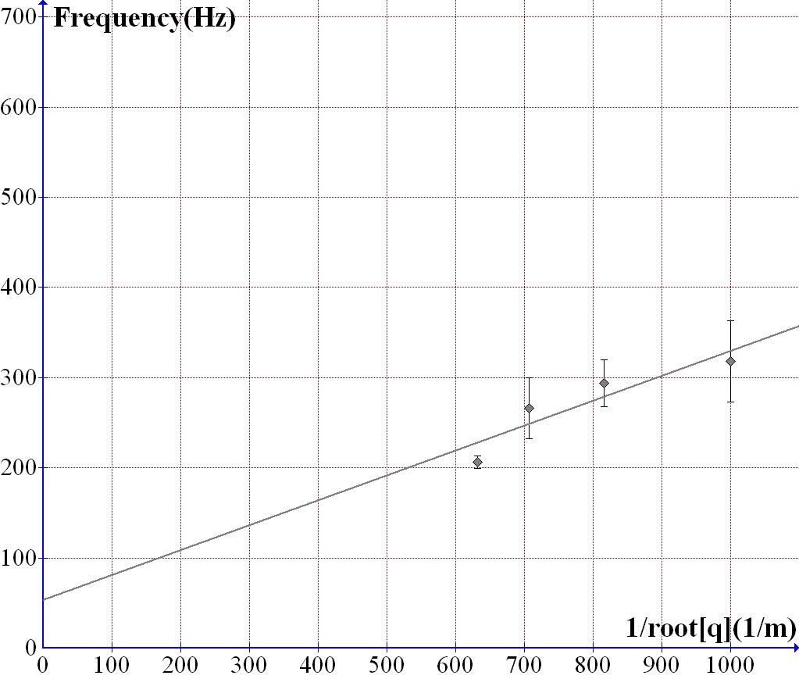
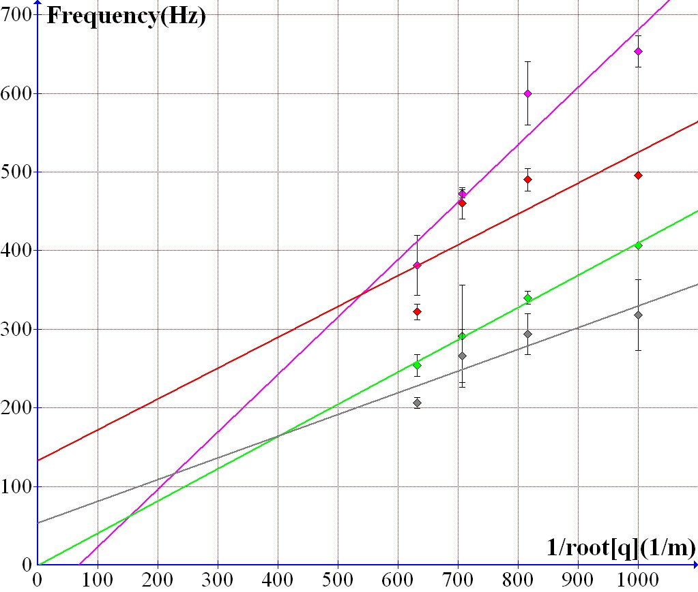
3. B) Effect of cross-section
Figure 11.1. Fundamental frequencies in the function of in the case of given lengths

Slide 12
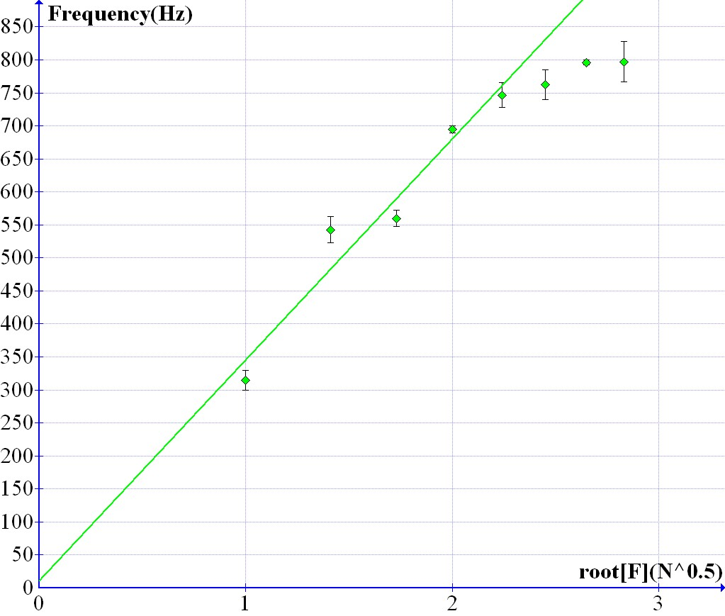
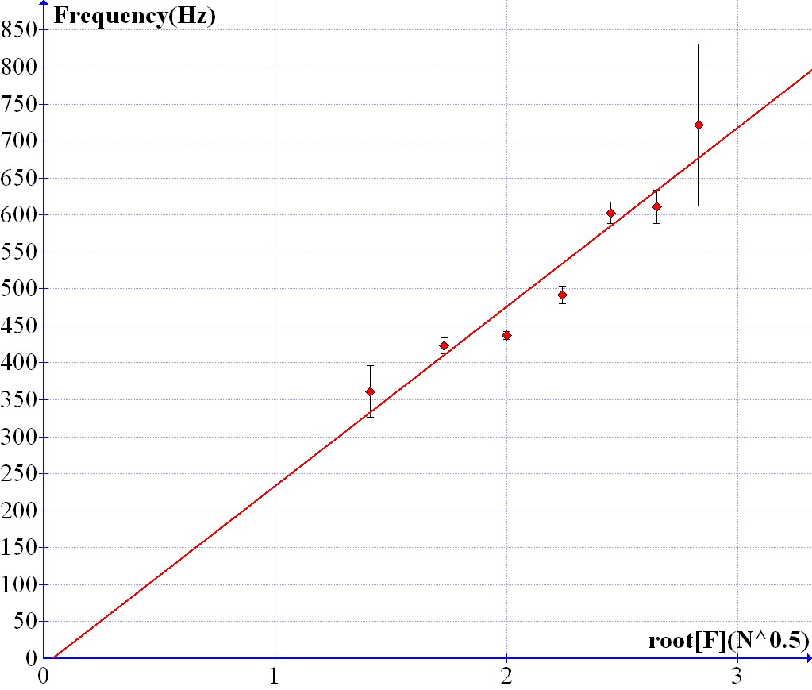
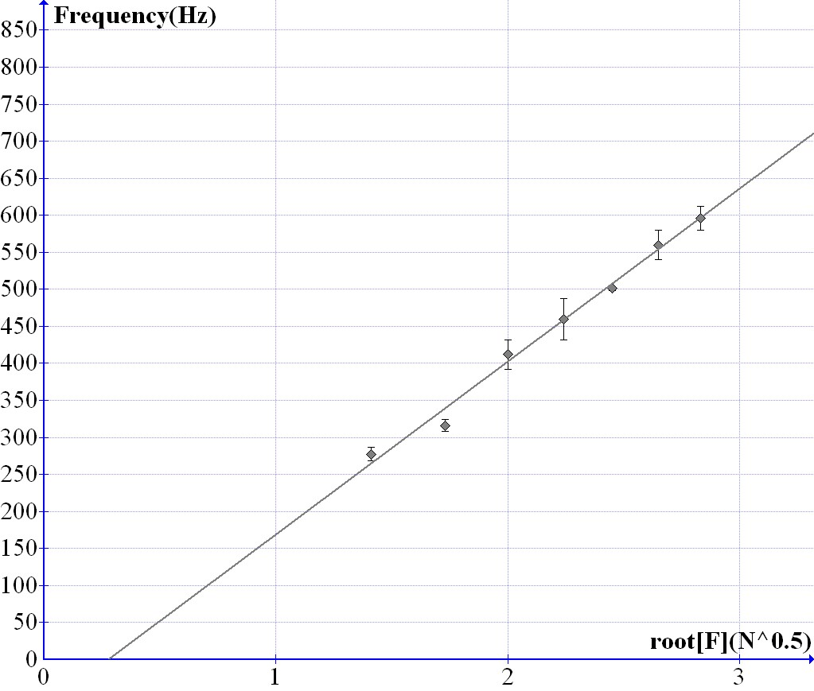
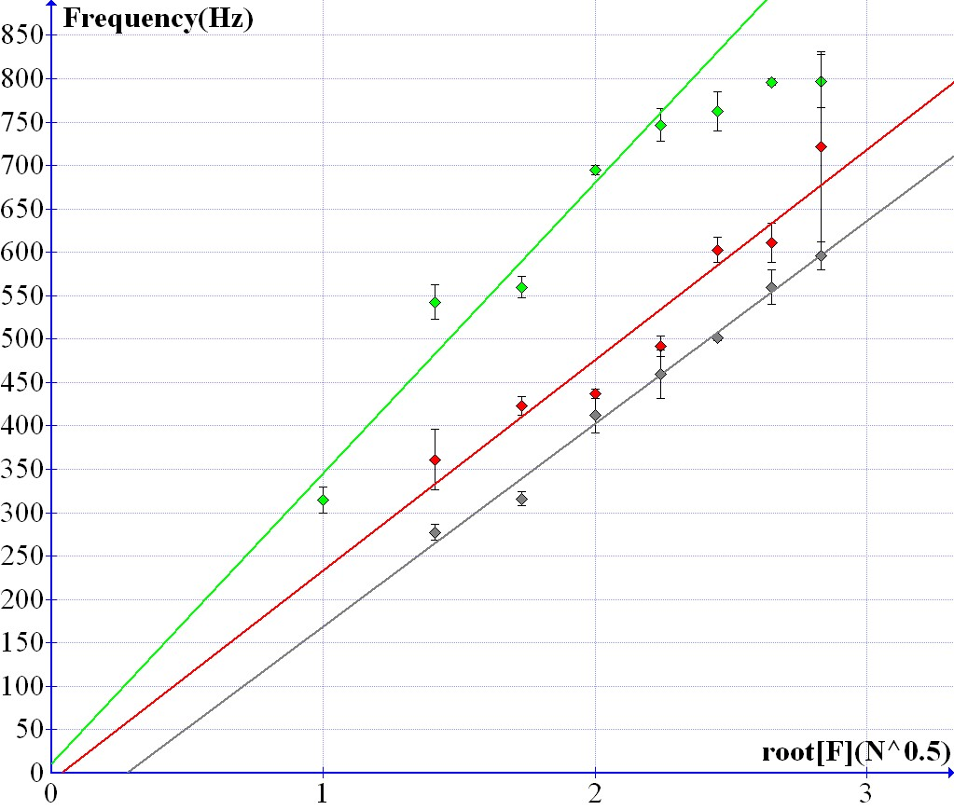
3. C) Effect of stress force
Figure 12.1. To different given tensions belonging fundamental frequency with 15-20-25mm wide paper strips

Slide 13
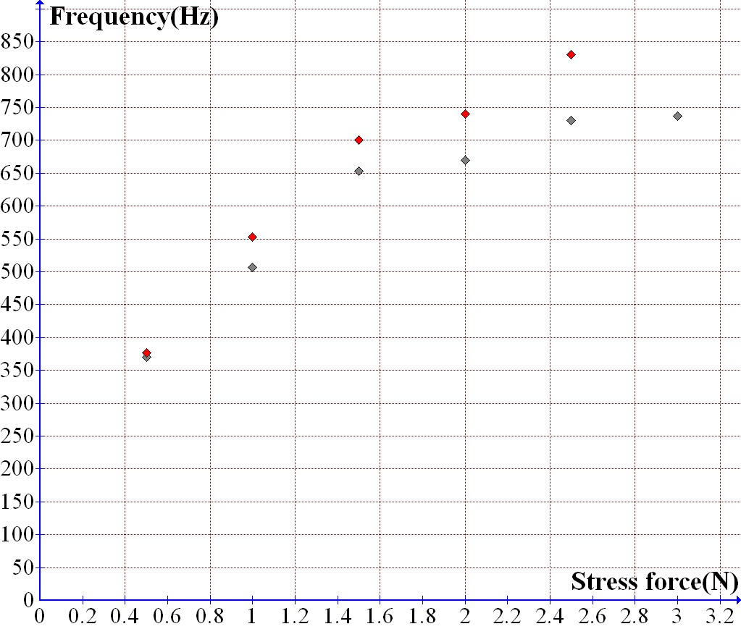
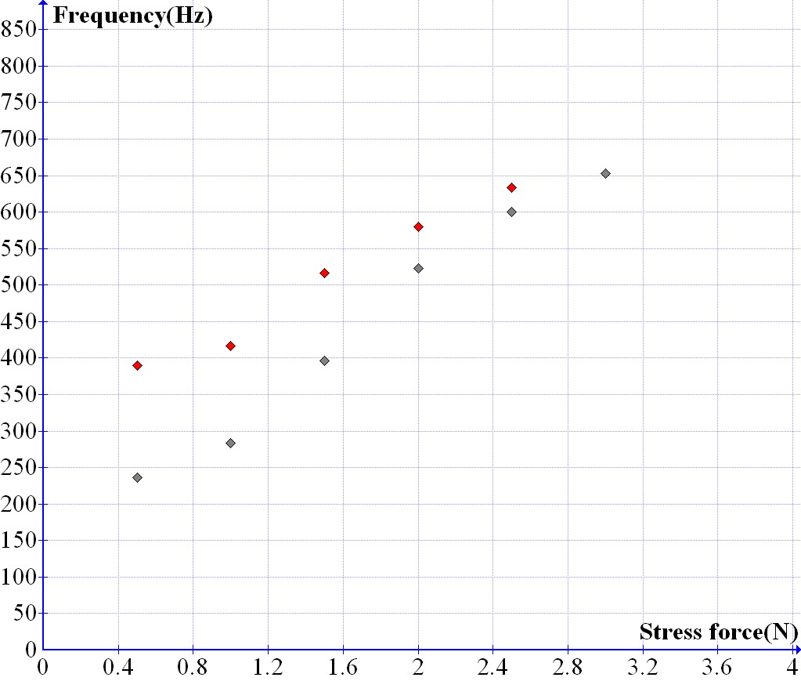
3. D) Hysteresis
Remnant effect of the stress force on the frequency: with chocolate paper and baking paper
decreasing stress force
decreasing stress force
increasing stress force
increasing stress force
Figure 13.1. Hysteresis with 15mmx50mm sized chocolate paper
Figure 13.2. Hysteresis with 15mmx50mm sized baking paper

Slide 14
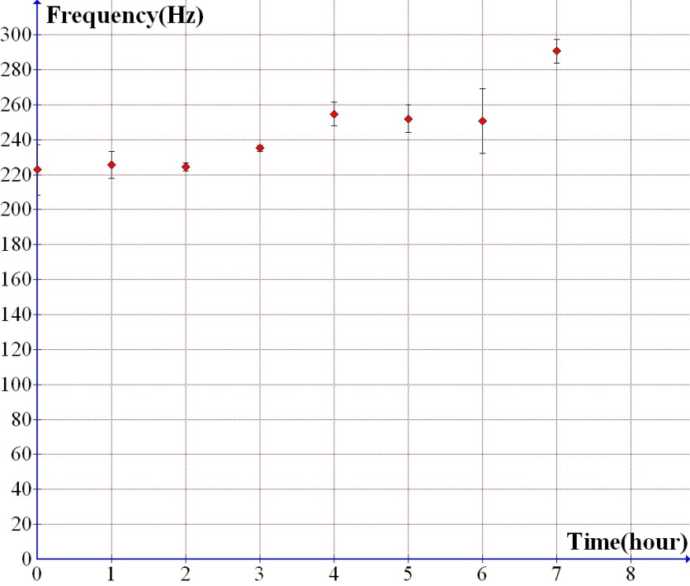
3. E) Quality of material
The measurement of the frequency as the function of the time of a drying grass strip.
Figure 14.1. The values of a 10mmx50mm sized blade of grass as the function of the time

Slide 15
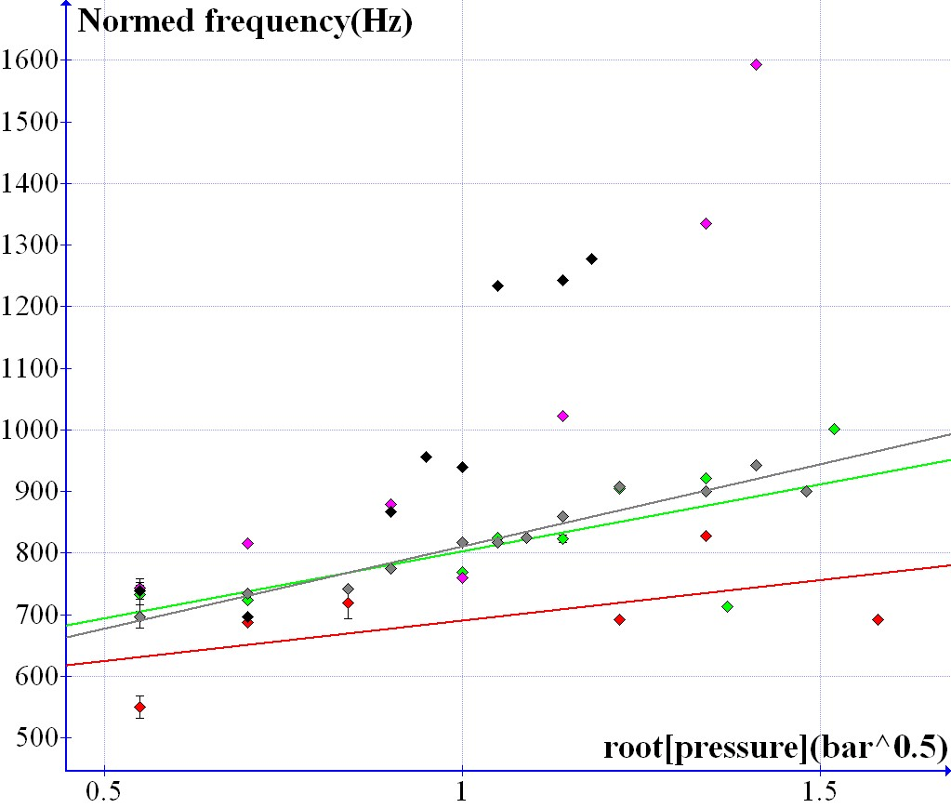
3. F) Cross direction vibration
String model: (normed frequency) independent of the pressure. But:
Figure 15.1. Both sides vibrating: cross direction vibration
Figure 15.2. Normed frequency (independent from the cross section) as the function of radical pressure

Slide 16
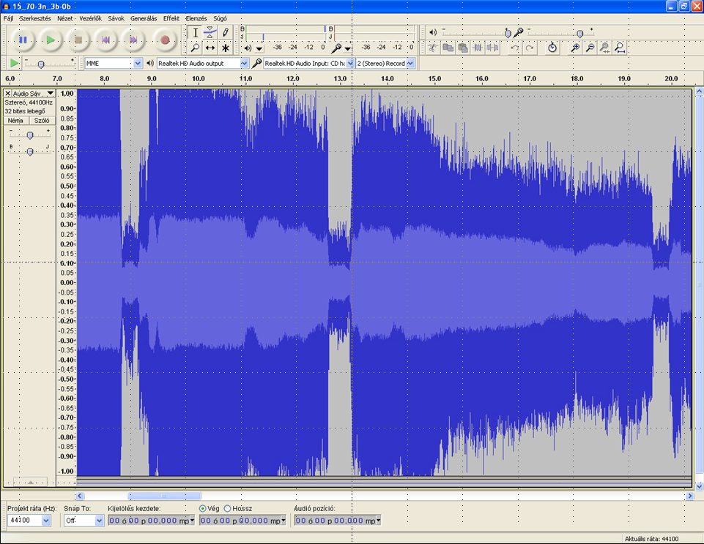
Volume-examination
Only sound of the airflow
16.1. Manometer of the compressor
Highest Transient Peak
Average RMS (Root Mean Square)

Slide 17
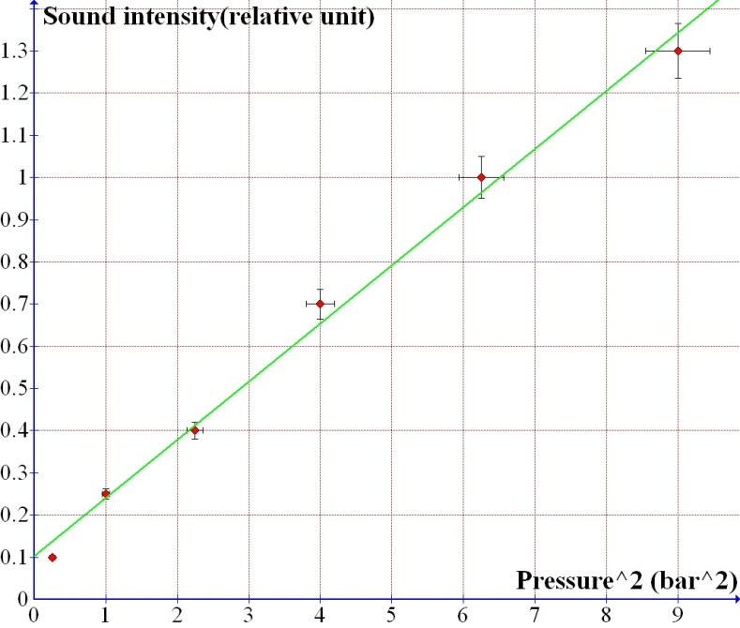
Volume-examination
Pressure of the airflow: from 3.5 bar down to 0 bar.
p: pressure, p_{s}: sound pressure, I: sound intensity, Z: sound impedance [4]
Figure 17.1. Sound intensity as the function of pressure square with a 15mmx70mm sized paper strip
R²=0.977, Error of measurement

Slide 18
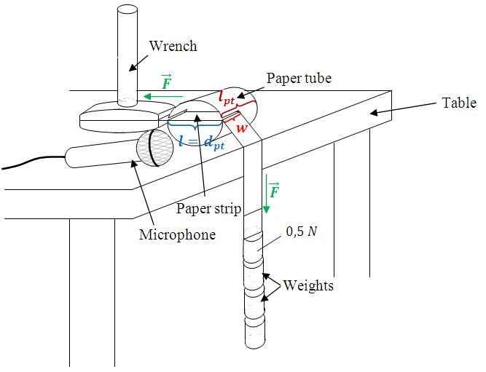
4. Instrument model
Figure 18.1. The blowing of a 50mm wide and 75mm long paper strip in a tube

Slide 19
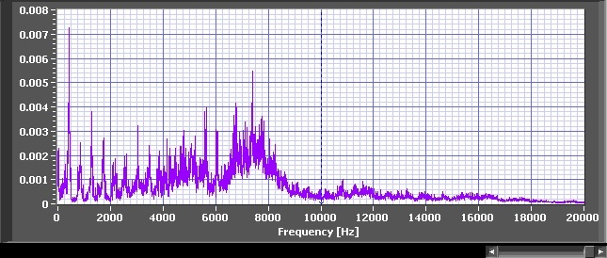
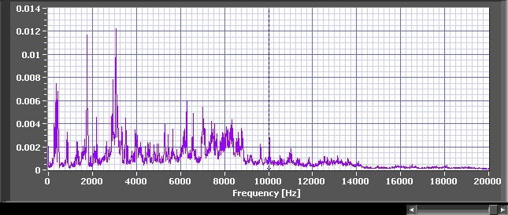
Figure 31.1. The blowing of the paper without the tube
Figure 19.2. The blowing of the paper with the tube

Slide 20
5.1. Summary of results
New and unexpected effect: cross direction vibrations
Pressure dependency of the frequency by strips (not strings)
Correspondence between sound intensity (I) and pressure of the airflow (p)

Slide 21
6. Sources
[1]Sadatoshi Taneda: Experimental Investigation of the Wakes behind Cylinders and Plates at Low Reynolds Numbers, Journal of the Physical Society of Japan. 11, pp. 302-307 (1956)
[2]http://www.vilaglex.hu/Fizika/Html/Hurosok.htm
[3]http://hu.wikipedia.org/wiki/Hiszter%C3%A9zis
[4]http://de.wikipedia.org/wiki/Schalldruck
Thank you for your attention!

